Slide 1
Introduction to TDD
Zoltan Szocs

Slide 2
What is T. Diddy?
SW development process that relies on automated test cases, that defines a desired function
The developer must understand the feature specs
Forces him to think in use cases and user stories, tests drive the development
Benefits: (c)leaner code, good coverage

Slide 3
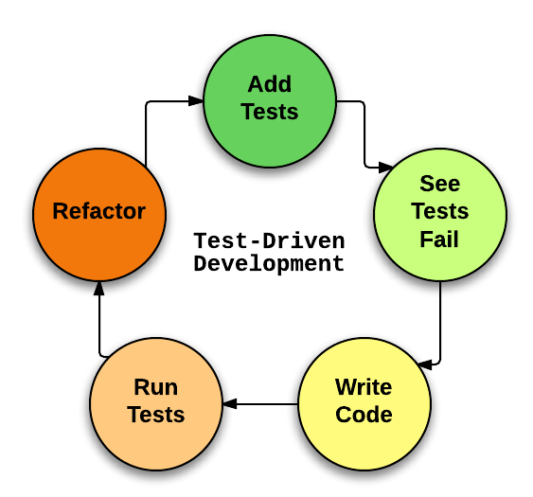
TDD cycle

Slide 4
Add Tests
Write the tests first, they are your documentation & specification
Make sure it’s well formulated
Cover the feature as good as possible
Helps you not to skew your view ( when you have a hammer … )
Given-When-Then

Slide 5
See it fail
This is the most contested cycle-element, but plays an important role
Confirms to you that your tests are failing when they should
Especially important when refactoring legacy code

Slide 6
Write code
KISS YAGNI

Slide 7
Run tests
Confirm the code you’ve written actually works
See if it conforms to specs
It helps if test output is human readable:
TEST_#213_2211_ACC_OK
factorial(): Test if result is 120 when called with 5

Slide 8
Refactor
Clean the cruft
Reorganize code as well as tests to make them more logical and clean
Apply clean coding standards, recognize & organize in patterns

Slide 9
Repeat … Until Done
Software development is all about loops ( for, while, Agile, spike-alpha-beta-gold )
Steps should be small, cycles should run frequently to give rapid feedback
Prefer undo & redo over lengthy debugging

Slide 10

Dealing with legacy code
Read:

Slide 11
Live coding

Slide 12
Q&A

